Slide 1
CS 1520 COMPUTER ARCHITECTURE
Assembly Language
8086 Instruction Set
Addressing Modes

Slide 2
Contents
8086 Register Addressing Modes
8086 Memory Addressing Modes
Displacement Only (or direct) Addressing Modes
Register Indirect Addressing Modes
Indexed Addressing Modes
Based Indexed Addressing Modes
Based Indexed plus Displacement Addressing Modes
Easy way to remember 8086 addressing modes

Slide 3
8086 Register Addressing Modes
Operate on the 8086’s general purpose register set
mov destination, source
The instruction copies the data from the source operand to the destination operand.
Both must be the same size
mov ax, bx ;Copies the value from BX into AX
mov dl, al ;Copies the value from AL into DL
mov si, dx ;Copies the value from DX into SI
mov sp, bp ;Copies the value from BP into SP
mov dh, cl ;Copies the value from CL into DH
mov ax, ax ;Yes, this is legal!

Slide 4
8086 Register Addressing Modes
Two restrictions on the use of the segment registers with the mov instruction.
you may not specify cs as the destination operand
only one of the operands can be a segment register
You cannot move data from one segment register to another with a single mov instruction. To copy the value of cs to ds, you'd have to use some sequence like:
mov ax, cs
mov ds, ax

Slide 5
8086 Memory Addressing Modes
The 8086 provides 17 different ways to access memory.
The addressing modes provided by the 8086 family include
displacement-only (or direct),
base,
displacement plus base,
base plus indexed,
displacement plus base plus indexed.

Slide 6
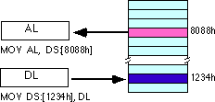
Displacement Only Addressing Mode
The displacement-only (or direct) addressing mode consists of a 16 bit constant that specifies the address of the target location.
The instruction mov al,ds:[8088h] loads the al register with a copy of the byte at memory location ???.
The instruction mov ds:[1234h],dl stores the value in the dl register to memory location ???.

Slide 7
Displacement Only Addressing Mode
The displacement-only (or direct) addressing mode consists of a 16 bit constant that specifies the address of the target location.
The instruction mov al,ds:[8088h] loads the al register with a copy of the byte at memory location 8088h.
The instruction mov ds:[1234h],dl stores the value in the dl register to memory location 1234h:

Slide 8
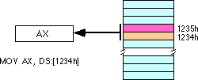
Displacement Only Addressing Mode
You can also access words on the 8086 processors :
By default, all displacement-only values provide offsets into the data segment.
To use different segment, you must use a segment override prefix before your address.
e.g., to access location 1234h in the extra segment (es),
use an instruction of the form mov ax,es:[1234h].

Slide 9
Register Indirect Addressing Modes
There are four forms of register indirect addressing modes
mov al, [bx]
mov al, [bp]
mov al, [si]
mov al, [di]
The [bx], [si], and [di] modes use the ds segment by default. The [bp] addressing mode uses the stack segment (ss) by default.
Use the segment override prefix symbols if access data in different segments.
mov al, cs:[bx]
mov al, ds:[bp]
mov al, ss:[si]
mov al, es:[di]

Slide 10
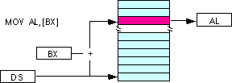

Register Indirect Addressing Modes
Note: the [si] and [di] addressing modes work exactly the same way, just substitute si and di for bx above.

Slide 11
Indexed Addressing Modes
The indexed addressing modes use the following syntax:
mov al, disp[bx]
mov al, disp[bp]
mov al, disp[si]
mov al, disp[di]
If bx contains 1000h, then the instruction mov cl,20h[bx] will load cl from memory location ???.
If bp contains 2020h, mov dh,1000h[bp] will load dh from location ???.
The addressing modes involving bx, si, and di all use the data segment, the disp[bp] addressing mode uses the stack segment by default.

Slide 12
Indexed Addressing Modes
The indexed addressing modes use the following syntax:
mov al, disp[bx]
mov al, disp[bp]
mov al, disp[si]
mov al, disp[di]
If bx contains 1000h, then the instruction mov cl,20h[bx] will load cl from memory location ds:1020h.
If bp contains 2020h, mov dh,1000h[bp] will load dh from location ss:3020.
The addressing modes involving bx, si, and di all use the data segment, the disp[bp] addressing mode uses the stack segment by default.

Slide 13
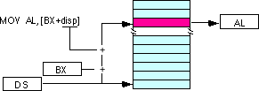

Indexed Addressing Modes
You can use the segment override prefixes to specify a different segment:
Mov al, ss:disp[bx]
Mov al, es:disp[bp]
Mov al, cs:disp[si]
Mov al, ss:disp[di]
substitute si or di in the figure above to obtain the [si+disp] and [di+disp] addressing modes.

Slide 14
Based Indexed Addressing Modes
These addressing modes form the offset by adding together a base register (bx or bp) and an index register (si or di).
mov al, [bx][si]
mov al, [bx][di]
mov al, [bp][si]
mov al, [bp][di]
Suppose that bx contains 1000h and si contains 880h. Then the instruction mov al,[bx][si] would load al from location ???.
If bp contains 1598h and di contains 1004, mov ax,[bp+di] will load the 16 bits in ax from locations ??? and ???.

Slide 15
Based Indexed Addressing Modes
These addressing modes form the offset by adding together a base register (bx or bp) and an index register (si or di).
mov al, [bx][si]
mov al, [bx][di]
mov al, [bp][si]
mov al, [bp][di]
Suppose that bx contains 1000h and si contains 880h. Then the instruction mov al,[bx][si] would load al from location DS:1880h.
If bp contains 1598h and di contains 1004, mov ax,[bp+di] will load the 16 bits in ax from locations SS:259C and SS:259D.

Slide 16
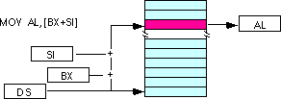
Based Indexed Addressing Modes
The addressing modes that do not involve bp use the data segment by default. Those that have bp as an operand use the stack segment by default.
You substitute di in the figure above to obtain the [bx+di] addressing mode.

Slide 17

Based Indexed Addressing Modes
You substitute di in the figure above for the [bp+di] addressing mode.

Slide 18
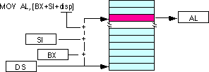
Based Indexed Plus Displacement Addressing Modes
Examples:
mov al, disp[bx][si]
mov al, disp[bx+di]
mov al, [bp+si+disp]
mov al, [bp][di][disp]
You may substitute di in the figure above to produce the [bx+di+disp] addressing mode.

Slide 19

Based Indexed Plus Displacement Addressing Modes
You may substitute di in the figure above to produce the [bp+di+disp] addressing mode.
Suppose bp contains 1000h, bx contains 2000h, si contains 120h, and di contains 5. Then mov al,10h[bx+si] loads al from address ???; mov ch,125h[bp+di] loads ch from location ???; and mov bx,cs:2[bx][di] loads bx from location ???.

Slide 20
Based Indexed Plus Displacement Addressing Modes
You may substitute di in the figure above to produce the [bp+di+disp] addressing mode.
Suppose bp contains 1000h, bx contains 2000h, si contains 120h, and di contains 5. Then mov al,10h[bx+si] loads al from address DS:2130; mov ch,125h[bp+di] loads ch from location SS:112A; and mov bx,cs:2[bx][di] loads bx from locations CS:2007 and CS:2008

Slide 21
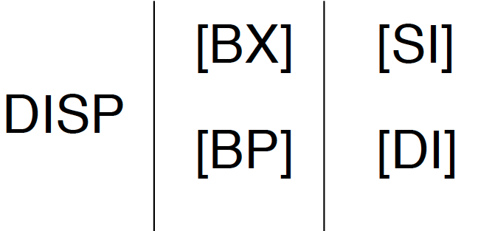
Table to Generate Valid 8086 Addressing Modes

Slide 22
An Easy Way to Remember the 8086 Memory Addressing Modes
There are a total of 17 different legal memory addressing modes on the 8086
Consider the table at the previous slide
If you choose zero or one items from each of the columns and wind up with at least one item, you’ve got a valid 8086 memory addressing mode.

Slide 23
An Easy Way to Remember the 8086 Memory Addressing Modes
Some examples:
Choose disp from column one, nothing from column two, [di] from column 3, you get disp[di].
Choose disp, [bx], and [di]. You get disp[bx][di].
Skip column one & two, choose [si]. You get [si]
Skip column one, choose [bx], then choose [di]. You get [bx][di]
Likewise, if you have an addressing mode that you cannot construct from this table, then it is not legal. For example, disp[dx][si] is illegal because you cannot obtain [dx] from any of the columns above.

Slide 24
Example
Count the number of characters in a string using:
Register Indirect Addressing Mode
Indexed Addressing Mode

Slide 25
Register Indirect Addressing Mode
Given that we have defined a string variable message as
message db ‘Hello’,0
The characters are stored in consecutive memory locations. (If the ‘H’ is in location 1024, then ‘e’ will be in location 1025, ‘l’ will be in location 1026 and so on.)
Indirect addressing: store the address of a location in a register and use this register to access the value stored at that location.

Slide 26
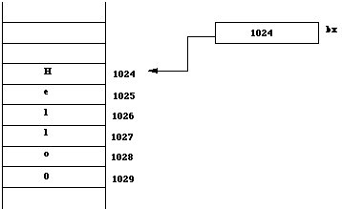
Figure: using the bx register for indirect addressing

Slide 27
Register Indirect Addressing Mode
Using the bx register for indirect addressing
[bx] reads as the value pointed to by bx, i.e. the contents of the location whose address is stored in the bx register.
cmp byte ptr [bx], 0 ; is this end of string?
This instruction compares the character (indicated by byte ptr) pointed to by bx with 0.

Slide 28
Register Indirect Addressing Mode
cx register stores the number of characters in the string.
message db ‘Hello’, 0
.......
........
mov cx, 0 ;cx stores number of characters
mov bx, offset message ;store address of message in bx
begin:
cmp byte ptr [bx], 0 ;is this end of string?
je fin ; if yes goto Finished
inc cx ; cx = cx + 1
inc bx ; bx points to next character
jmp begin
; cx now contains the number of characters in message
fin:
Note: If you omit the 0 character when defining the string, the above program will fail. Why?

Slide 29
Indexed Addressing Mode
index register is used to hold the subscript value
Example using indexed addressing:
message db ‘Hello’, 0
.......
........
mov cx, 0 ;cx stores number of characters
mov bx, 0 ;bx=0, index register
begin:
cmp message[bx], 0
je fin ; if message[bx]==0, go to fin
inc bx ; bx = bx + 1
inc cx ; cx = cx + 1
jmp begin
; cx now contains the number of characters in message
fin:

